Slide 1
CS3071 : Operating Systems Laboratory A.Y. 2021-2022 ( Autumn )
Faculty : Dr. Bidyut Kumar Patra

Slide 2
Process Management (System Calls)
13/09/2021 , 13:15 – 16:15 hours

Slide 3
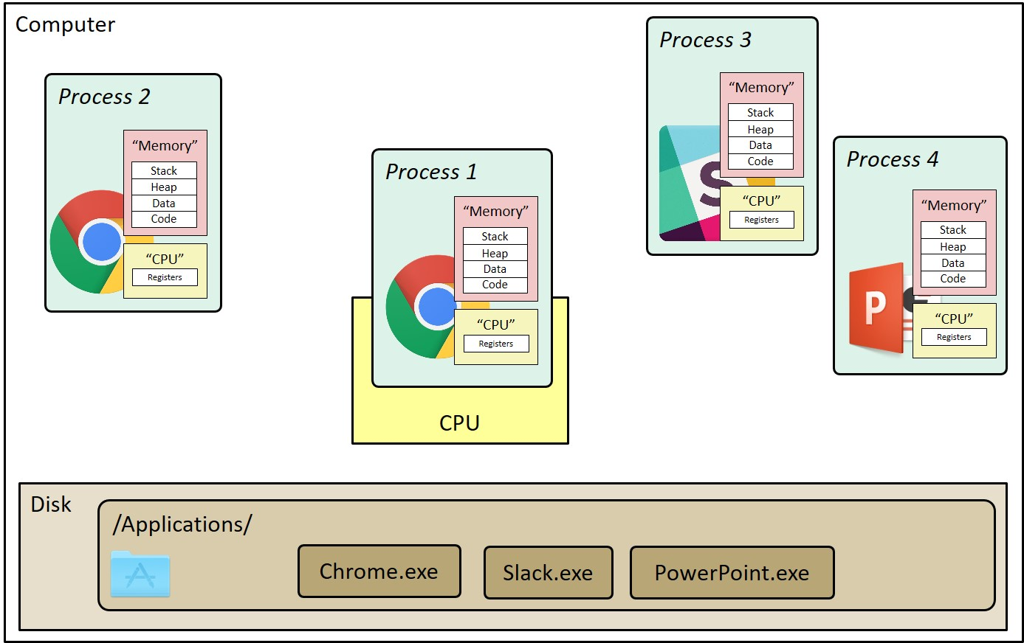
What is Process?
A process is an instance of a running program.
Process provides each program with two key abstractions:
Logical control flow
Each program seems to have exclusive use of the CPU.
Provided by kernel mechanism called context switching.
Private address space
Each program seems to have exclusive use of main memory.
Provided by kernel mechanism called virtual memory.

Slide 4
What is System Call?
Programming interface to the services provided by the OS.
Typically written in a high-level language (C or C++).
Mostly accessed by programs via a high-level Application Program Interface (API) rather than direct system call use.
Three most common APIs are Win32 API for Windows, POSIX API for POSIX-based systems (including virtually all versions of UNIX, Linux, and Mac OS X), and Java API for the Java virtual machine (JVM).

Slide 5
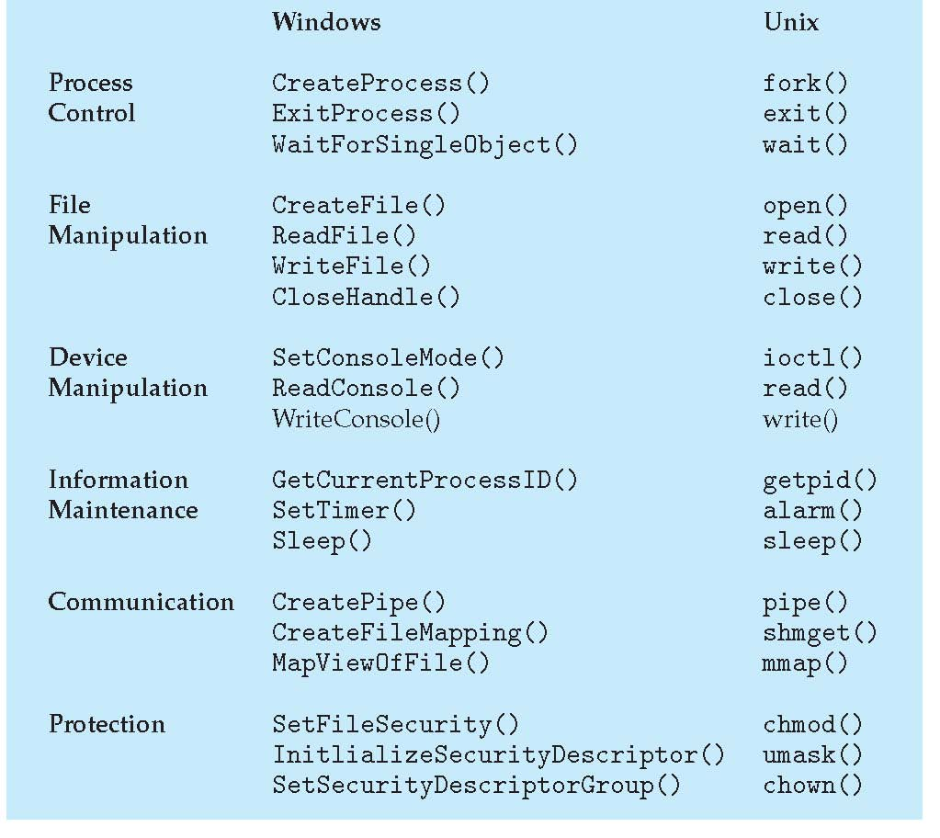
Examples of Windows and Unix System Calls

Slide 6
System Calls for Process Management in UNIX
fork()
exec*( ) family
wait()
exit()

Slide 7
fork( ) - Creating New Processes
pid_t fork(void)
Creates a new “child” process that is identical to the calling “parent” process. “child” gets an identical (but separate) copy of the “parent’s” virtual address space including all state (memory, registers, etc.)
Returns 0 (zero) to the child process.
Returns child’s process ID (PID) to the parent process.
Returns a negative value if the creation is unsuccessful.
After a new child process is created, both processes will execute the next instruction following the fork( ) system call.
Header file to include - #include <unistd.h> or #include <sys/types.h>

Slide 8
Understanding fork( )
The kernel does the following sequence of operations for fork system call :
It allocates a slot in the process table for the new process.
It assigns a unique ID number to the child process.
It makes a logical copy of the context of the parent process.
It increments counters for files associated with the process.
It returns the ID number of the child to the parent process, and a 0 (zero) value to the child process.

Slide 9
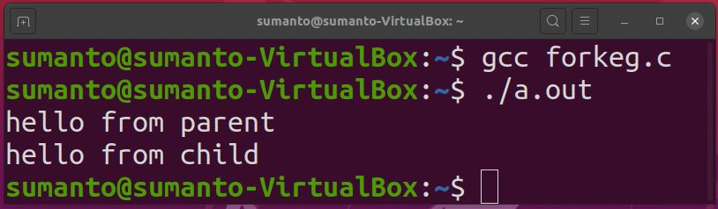
pid_t pid = fork();
if (pid == 0) {
printf("hello from child\n");
} else {
printf("hello from parent\n");
}
Process X (Parent)
Process Y (Child)
pid_t pid = fork();
if (pid == 0) {
printf("hello from child\n");
} else {
printf("hello from parent\n");
}
pid_t pid = fork();
if (pid == 0) {
printf("hello from child\n");
} else {
printf("hello from parent\n");
}
pid_t pid = fork();
if (pid == 0) {
printf("hello from child\n");
} else {
printf("hello from parent\n");
}
pid_t pid = fork();
if (pid == 0) {
printf("hello from child\n");
} else {
printf("hello from parent\n");
}
pid = Y
pid = 0

Slide 10
Example: Two consecutive forks
Bye
void fork2() {
printf("L0\n");
fork();
printf("L1\n");
fork();
printf("Bye\n");
}
printf
L1
Bye
printf
fork
printf
Bye
printf
L0
L1
Bye
printf
fork
printf
fork
printf
Example: Three consecutive forks
void fork3() {
printf("L0\n");
fork();
printf("L1\n");
fork();
printf("L2\n");
fork();
printf("Bye\n");
}
Bye
L2
Bye
Bye
L1
L2
Bye
Bye
L2
Bye
Bye
L0
L1
L2
Bye

Slide 11
getpid( ), getppid( ) - get process identification
getpid() - returns the process ID (PID) of the calling process. (This is often used by routines that generate unique temporary filenames.)
getppid() - returns the process ID of the parent of the calling process. This will be either the ID of the process that created this process using fork(), or, if that process has already terminated, the ID of the process to which this process has been reparented (either init( ) or a "subreaper" process defined via the prctl( ) PR_SET_CHILD_SUB‐REAPER operation).

Slide 12
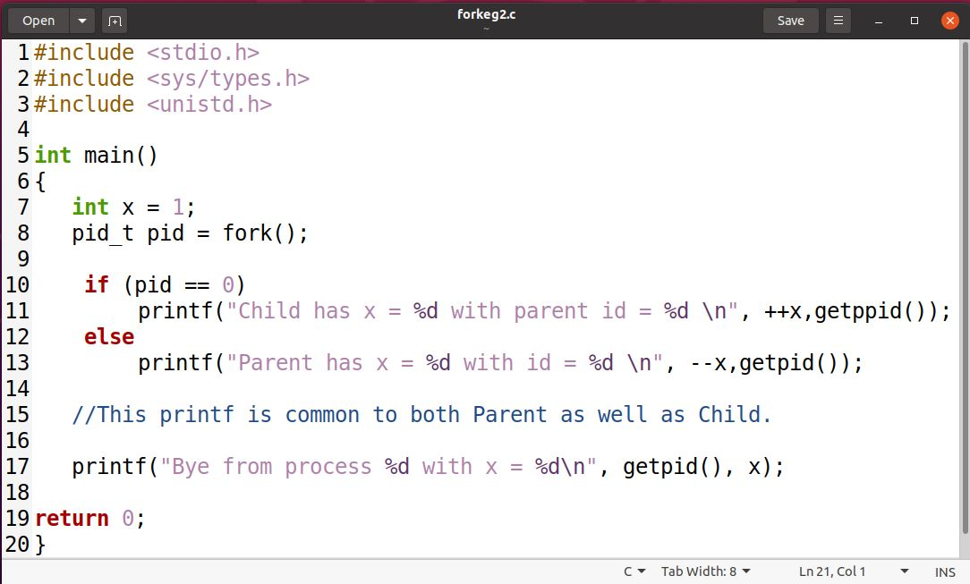
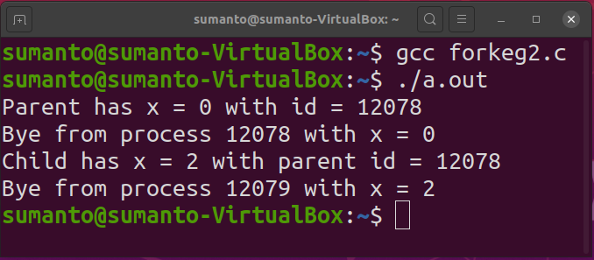
x=2
Child
Bye
++x
printf
printf
x=0
Parent
Bye
x=1
fork
--x
printf
printf

Slide 13
exec*( ) Family
The exec family replaces the current process’ code and address space with the code for a different program.
Commonly a process generates a child process because it would like to transform the child process by changing the program code the child process is executing.
The text, data and stack segment of the process are replaced and only the user area of the process remains the same.
The versions of exec are:
execl( )
execv( )
execle( )
execve( )
execlp( )
execvp( )
Header file to include - #include <unistd.h>

Slide 14
The functions can be grouped based on the letters following the "exec" prefix
Letter | Description
l | The const char *arg and subsequent ellipses can be thought of as arg0, arg1, ..., argn. Together they describe a list of one or more pointers to null-terminated strings that represent the argument list available to the executed program
v | The char *const argv[] argument is an array of pointers to null-terminated strings that represent the argument list available to the new program. The first argument, by convention, should point to the filename associated with the file being executed. The array of pointers must be terminated by a null pointer.
e | The environment of the caller is specified via the argument envp. The envp argument is an array of pointers to null-terminated strings and must be terminated by a null pointer.
p | The current PATH string should be used when the system searches for executable files
execv ( ) Syntax
int execv(const char *path, char *const argv[]);
path: should point to the path of the file being executed.
argv[]: is a null terminated array of character pointers argument list available to the new program.

Slide 15
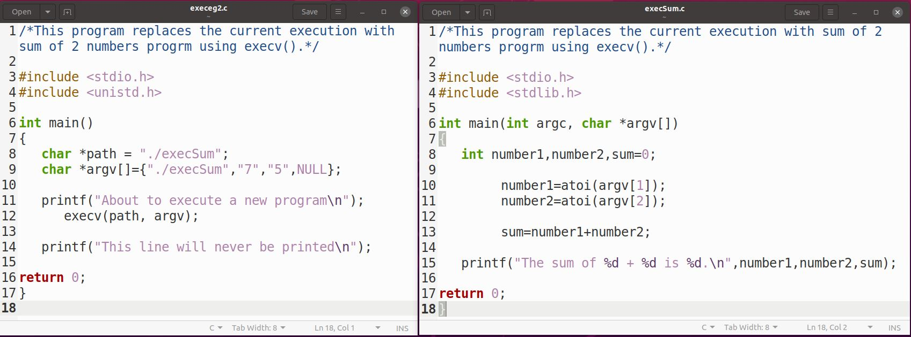
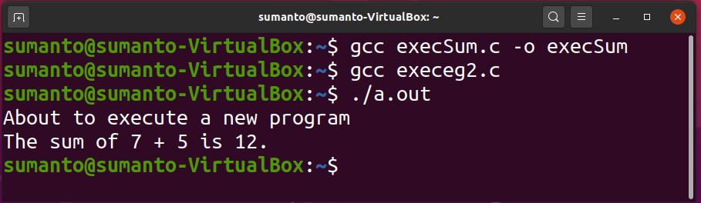

Slide 16
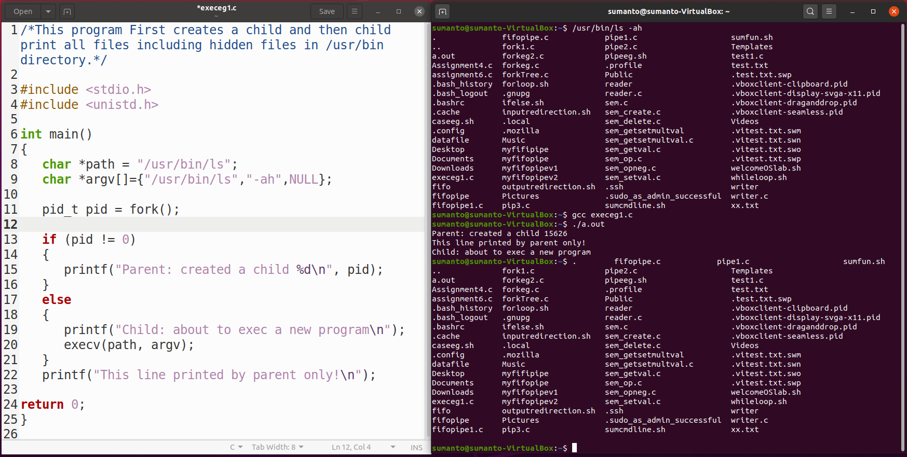

Slide 17
exit ( ) - Ending a process
The exit operation typically performs clean-up operations within the process space before returning control back to the operating system.
When the child process terminates ("dies"), either normally by calling exit, or abnormally due to a fatal error or signal (e.g., SIGTERM, SIGINT, SIGKILL), an exit status is returned to the operating system and a SIGCHLD signal is sent to the parent process.
The exit status can then be retrieved by the parent process via the wait system call.
void exit(int status);
Status code: 0 is used for a normal exit, nonzero for abnormal exit.

Slide 18
Orphans and Zombies Processes
A child process whose parent process has terminated in a special manner is known as Orphan process. Such an orphan process becomes a child of a special process.
A zombie process, which is a child process that has terminated but whose exit status is ignored by its parent process. Such a process becomes the child of a special process, which retrieves the child's exit status and allows the operating system to complete the termination of the dead process.

Slide 19
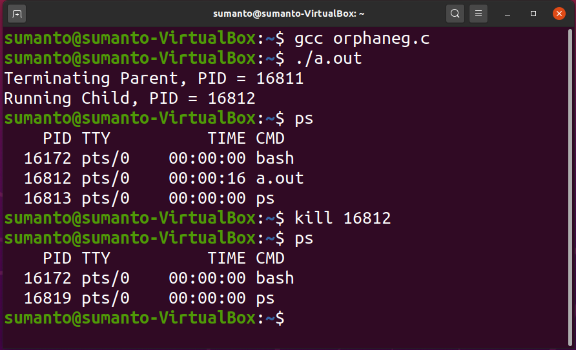
...
if (fork() == 0)
{
/* Child */
printf("Running Child, PID = %d\n", getpid());
while (1); /* Infinite loop */
}
else
{
printf("Terminating Parent, PID = %d\n", getpid());
exit(0);
}
...
Example of Orphan
Processes
Child process still active even though parent has terminated
Must kill explicitly, or else will keep running indefinitely

Slide 20
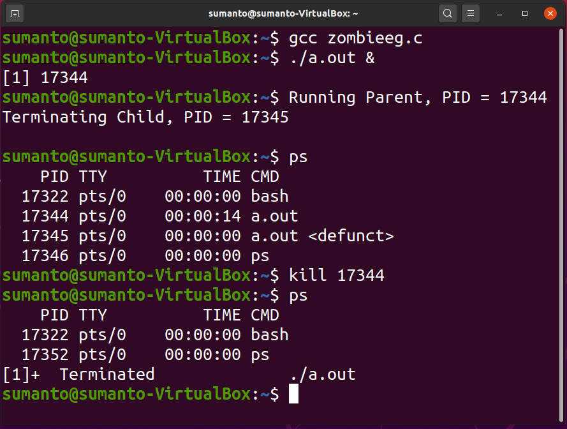
...
if (fork() == 0)
{
/* Child */
printf("Terminating Child, PID = %d\n",getpid());
exit(0);
}
else
{
printf("Running Parent, PID = %d\n",getpid());
while (1); /* Infinite loop */
}
...
Example of Zombie Processes
ps shows child process as “defunct”
Killing parent allows child to be reaped by init.

Slide 21
wait( ) - Synchronizing with Children
int wait(int *child_status)
Suspends current process (i.e. the parent) until one of its children terminates.
Return value is the PID of the child process that terminated.
On successful return, the child process is reaped
If child_status != NULL, then the *child_status value indicates why the child process terminated.
Special macros for interpreting this status – see man wait(2)
Header file to include - #include <sys/wait.h> or #include<sys/types.h>

Slide 22
wait( ) - Synchronizing with Children
...
int child_status;
if (fork() == 0)
{
printf("HC: hello from child\n");
exit(0);
}
else
{
printf("HP: hello from parent\n");
wait(&child_status);
printf("CT: child has terminated\n");
}
printf("Bye\n");
...
HC
exit
printf
HP
Bye
fork
printf
wait
printf

Slide 23
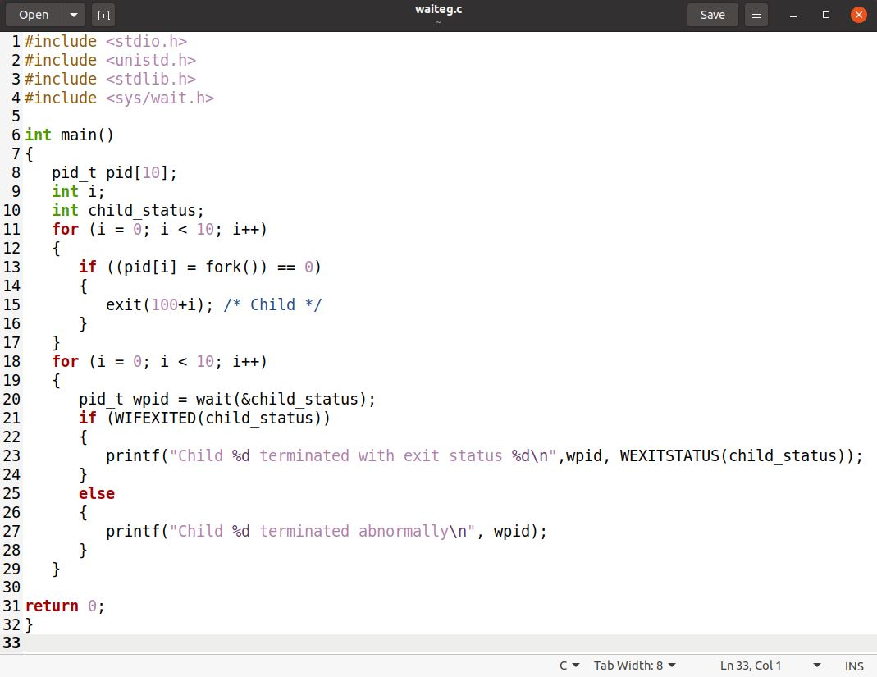
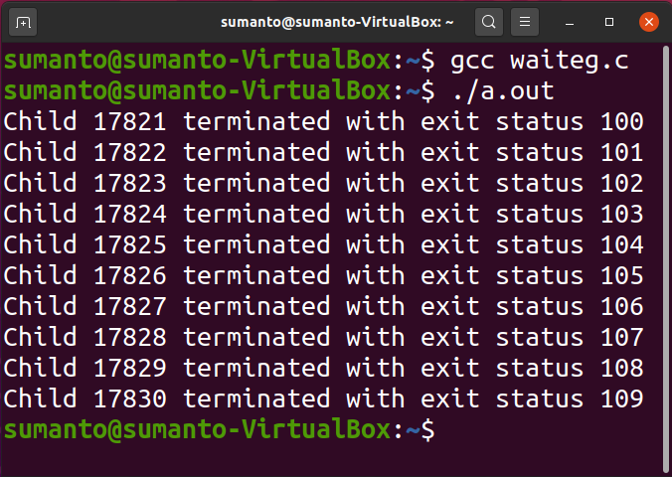
If multiple children completed, will take in arbitrary order.
Can use macros WIFEXITED and WEXITSTATUS to get information about exit status.

Slide 24
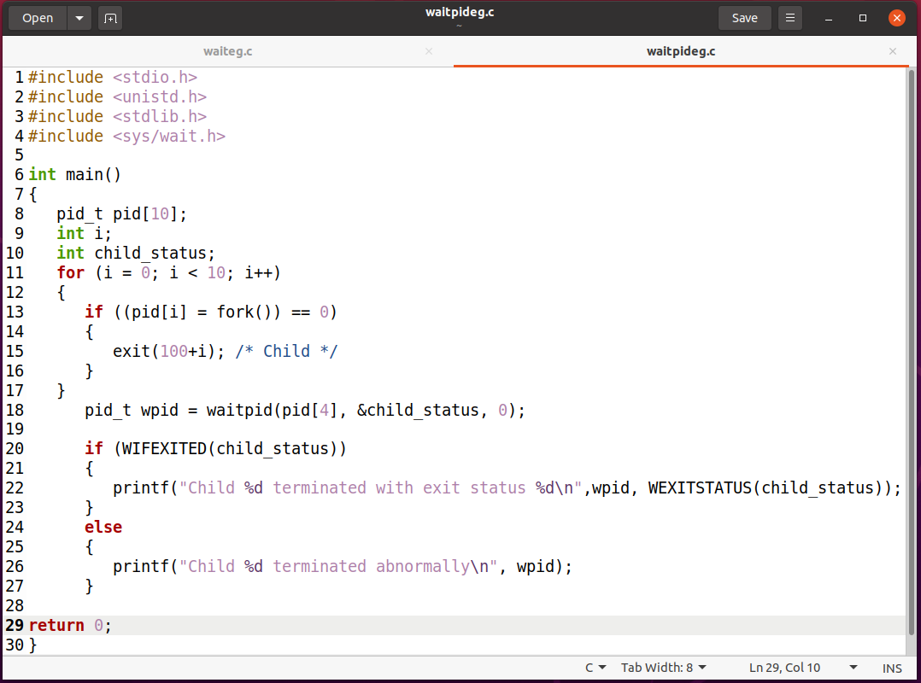
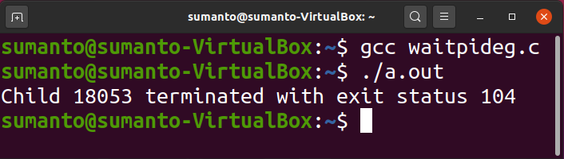
waitpid( ) - Waiting for a Specific Process
pid_t waitpid(pid_t pid, int &status, int options)

Slide 25
Thank You.

